Slide 1
Animation and Smooth Skinning

Slide 2
Animation
Frame-by-frame
  Sprites, spritesheets, mesh flipbooks
Keyframed animation concepts: keyframes and in-between interpolation
LERP (linear interpolation) and SLERP (spherical linear interpolation)
Storing curve data: keyframes and tangents
Computing curves in an animation clip with an animation player
Loading curve data from FBX
Hierarchical animation

Slide 3
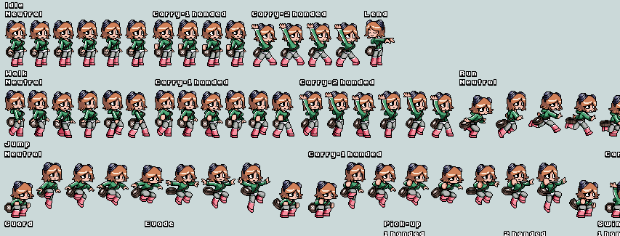
Spritesheet

Slide 4
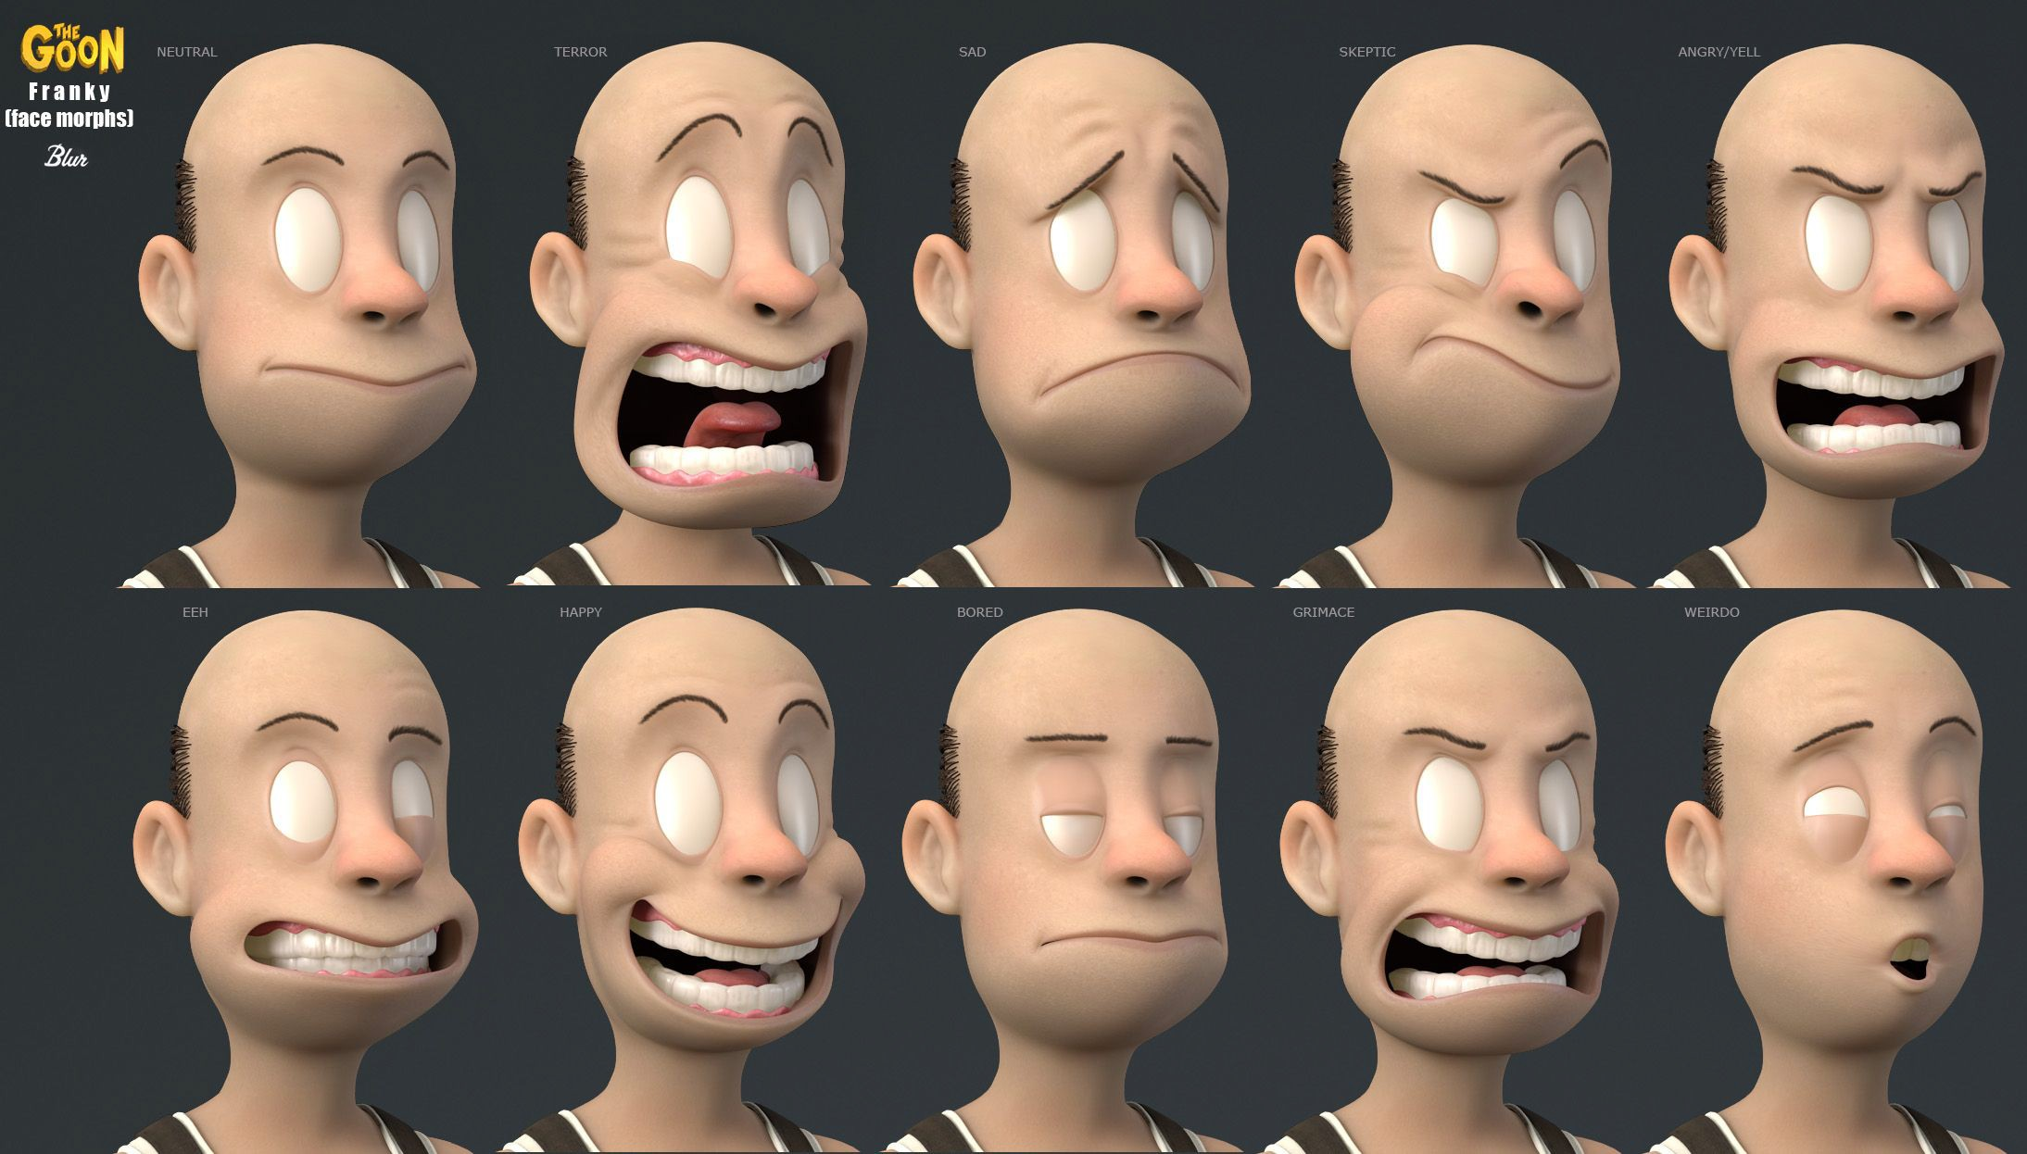
Per-vertex animation
30 frame animation for 3000 verts with 12-byte position per vert per frame == 1.0 MB
Doesn’t scale well.
Image courtesy of DeletionQuality forums...

Slide 5
Procedural animation
Rigidbody, ragdoll, soft body, deformation from sound, data-driven
Pipeline consistency between DCC tools and engine
Hard because codepath isn’t the same!
For keyframed curves, math is fairly standard, deterministic, and keys are reliable
Physics simulation is subject to variability due to differences in implementation, entirely dependent on initial state and iterative function, no way to ensure results are the same
Alembic solution: cache the results of the simulation in the DCC,
Havok, Houdini: engine middleware with DCC tool or plugin

Slide 6
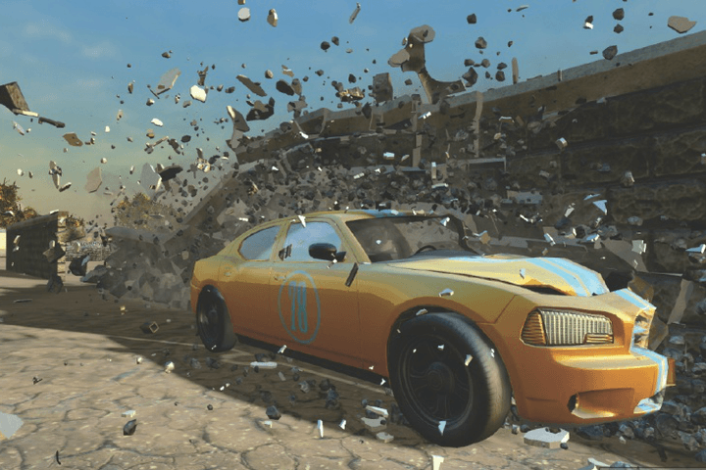
Havok

Slide 7
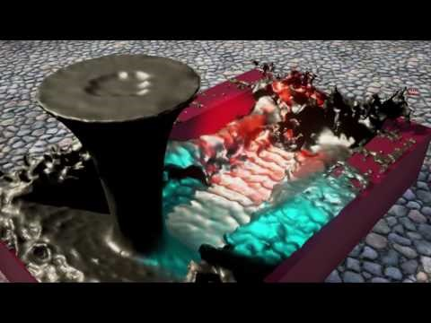
Bitfrost liquid simulation->Alembic->UE4

Slide 8
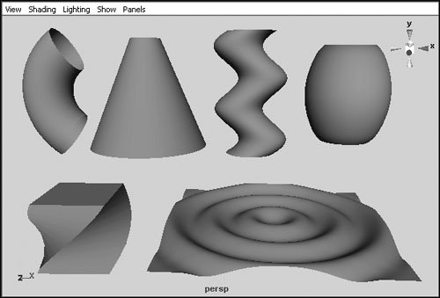
Deformers
Anything that changes the surface of the mesh
Does not change its topology
Examples from Maya: squash deformer, sine wave deformer, blend shape deformer
These affect the positions of vertices on a mesh
Vertex positions are in Model Space

Slide 9
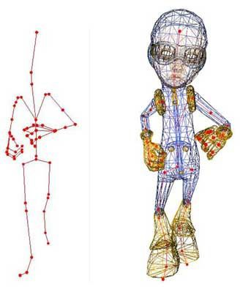
Smooth skinning (Skeletal Subspace Deformation)
Transform vertices relative to joints with blended influences
Treats vertices as the skin, and animation is defined as transformations of the skeleton

Slide 10
Spaces
A transformation matrix can transform a point within a space, or it can express the transformation of frame of reference such as world space to view space for the camera.
World space: position of a vertex relative to world origin
Model space: position relative to model origin
Joint space: position relative to a joint
Bind space: position of vertices in bind pose (e.g. T-pose)
Pose: a particular configuration of the skeleton
Pose space: position of vertices relative to a Pose

Slide 11
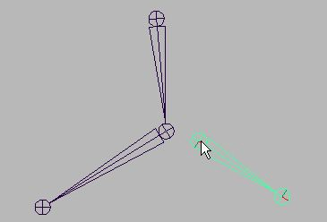
Skeletons
Joints
Hierarchy
Representation
Update
T-pose
Sometimes referred to as bones.
Define a coordinate space within a model.
Image courtesy of Autodesk.

Slide 12
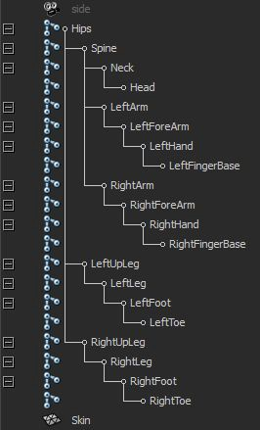
Skeletons
Joints
Hierarchy
Representation
Update
T-pose
Image courtesy of Carleton University.

Slide 13
Skeletons
struct Joint
{
Matrix4x3 m_invBind;
const char* m_name;
uint8_t m_parent;
};
struct ga_joint
{
const char _name[32];
ga_mat4f _world;
ga_mat4f _inv_bind;
ga_mat4f _skin;
uint32_t _parent;
};
Joints
Hierarchy
Representation
Update
T-pose

Slide 14
Skeletons
Joints
Hierarchy
Representation
Update
T-pose
For each joint in the hierarchy:
Update the joint’s local transform from animation data.
Multiply by parent transform to obtain world space transform.
Multiply by inverse bind matrix to obtain skinning matrix.
That last bit will make more sense soon.

Slide 15
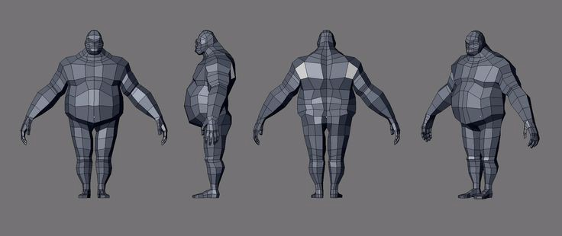
Skeletons
Joints
Hierarchy
Representation
Update
T-pose
Image courtesy of Pintrerest..

Slide 16
Skinning
Ok, so how do we get the skin to follow the skeleton?
Vertices of a model are bound to the skeleton.
  Each vertex has some small number, often four, of joints that influence it.
  The amount of influence is described by a weight, from 0 to 1.
  The process of assigning joint weights to vertices is called weight painting.
To move the skin, we move each vertex using the influencing joints.

Slide 17
Mathematics
Concept
Equations
Algorithm
We need to transform a vertex from binding space to pose space.
Vertex position is always constant relative to joint influencing it.
Transform to local joint space, pose, then transform back to model space.

Slide 18
Mathematics
Concept
Equations
Algorithm
We need to transform a vertex from binding space to pose space.
Vertex position is always constant relative to joint influencing it.
Transform to local joint space, pose, then transform back to model space.

Slide 19
Origin
Notes:
Rotation of joint

Slide 20
Mathematics
Concept
Equations
Algorithm
We need to transform a vertex from binding space to pose space.
Vertex position is always constant relative to joint influencing it.
Transform to local joint space, transform into the pose, then transform back to model space.

Slide 21
Origin
Notes:
Point is the same in joint space

Slide 22
Think of this like a moon orbiting a planet. As the planet moves, the moon moves with it, at roughly a constant distance away.
Origin

Slide 23
Mathematics
Concept
Equations
Algorithm
We need to transform a vertex from binding space to pose space.
Vertex position is always constant relative to joint influencing it.
Transform to local joint space, pose, then transform back to model space.

Slide 24
Origin
Model (binding) space.
Notes:
Point in model space, bind pose

Slide 25
Origin
Joint space.

Slide 26

Origin
Pose space.
Notes:
Transform joint to pose space

Slide 27
Origin
Model (pose) space.
Notes:
Transform point back to model space

Slide 28
The Binding Matrix
The binding matrix describes a joint’s transform in model space.
Or in other words, the binding matrix will transform a point relative to a joint into model space.
Which means…
The inverse binding matrix will transform a point in model space to a point relative to a joint.
Notes:
Binding matrix is the pose of the joint at time of binding, in model space
So it can also transform other points relative to the joint into model space
So inverse will go from model to joint space

Slide 29
Mathematics
Concept
Equations
Algorithm
First obtain a vertex’s position relative to a joint:
Given B_{j→M}, the bind matrix of joint j, and vertex v in the bind position (denoted by superscript B), multiply v by the inverse binding matrix:
Notes:
Vertex in joint space is vertex in bind pose in model space times inverse of bind matrix

Slide 30
Mathematics
Concept
Equations
Algorithm
Given C_{j→M}, the current pose of joint j, we can convert v into the current pose by multiplying it by C:
So…
Where K_{j} is known as the skinning matrix.
Notes:
Vertex in current pose in model space =
Vertex in joint space * current pose of joint in model space
Vertex in joint space = vertex in bind pose model space * inverse bind pose matrix
K = skinning matrix = inverse bind pose * current pose

Slide 31

Origin
Notes:
Vertex in bind pose model space

Slide 32

Origin
Notes:
Get vertex in joint space

Slide 33

Origin

Slide 34

Mathematics
Concept
Equations
Algorithm
For multiple joints, average the positions of the vertex skinned by each influencing joint:
Where w_{i} is the weight of joint i.

Slide 35
Mathematics
Concept
Equations
Algorithm
Commonly, skinned animation is done by:
Updating skeletons on the CPU.
Pushing joint data to the GPU.
Performing skinning calculations in the vertex shader.
The skinned vertex position is then multiplied by the model-view-projection matrix to obtain its final clip space coordinates.

Slide 36
Animation Clips
A game is driven by user input, and is therefore unpredictable.
Instead of lengthy animated sequences, short animation clips are made ready to be played depending on the player’s input.
Examples might include…
  Walk
  Run
  Jump
  Land

Slide 37
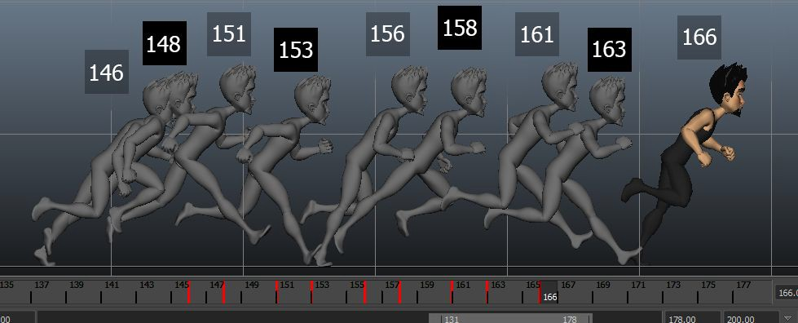
Animation Clips
Timelines
Creation
Playback
Interpolation
Image courtesy of animationmethods.wordpress.com.

Slide 38
Animation Clips
Timelines
Creation
Playback
Interpolation
Keyframes are points on the timeline where a model’s pose is recorded.
Poses are interpolated to fill the time between keyframes.
The more keyframes, the more control being exerted over the animation.

Slide 39
Animation Clips
Timelines
Creation
Playback
Interpolation
There are three common types of playback:
One time
Looping
Ping-pong
A playing animation can be considered to have its own local timeline.
t = 0 is the beginning, t = n is the end where n is the animation length.
t can be scaled for slow or fast motion

Slide 40
Animation Clips
Timelines
Creation
Playback
Interpolation
A game doesn’t run at the exact rate an animation is defined, and an animation is not keyframed at regular intervals.
Thus, we need to interpolate joint transforms between keyframes based on t.
Best method depends on transform:
Lerp for translation.
Slerp for orientation.

Slide 41
Blending
To create believable movement, multiple animations can be played simultaneously and blended together.
For example, a character may be transitioning from walking to running.
  In order to avoid a very visible switch from a walk cycle to a run cycle, the game may execute a smooth blend between the two.

Slide 42
Blending
The smooth transition from one animation to another is known as
cross-fading.
  Over a period of time t, animation A starts at 100 percent influence and ends at 0 percent, and animation B starts at 0 and ends at 100.

Slide 43
Blending
Another common type of blending is known as additive blending.
In this scenario, the motion from one animation is added on top of another.
  For example, a character may be running, and at the same time a “look at” animation is added on top to make them look at a target.
  Or, a character may crouch and a “pick up” animation may be blended over it.
Care must be taken to blend animations that do not have heavy contention over joints.
Animation layers offer a way for animations to be restricted to portions of a
skeleton.
  For example, one layer may target legs, while another targets torso.
  Clever use of animation layers can lead to very complex, believable motion.

Slide 44
Blending
Mathematically, blending can be achieved by lerping between two target transforms, similar to lerping between frames within an animation.
So, given pose M_{Ai} for joint i in animation A, and pose M_{Bi} for joint i in animation B:

Slide 45
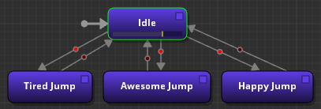
State Machines
At the highest level, it’s common to have an animation state machine.
  A finite state machine controlling animation state.
Responsible for smooth transitions between states.
Individual states may be a single animation clip or a collection of blended clips.
Serves as a simple interface for external systems to control character motion.

